Slide 1
Voters’ Meeting
Lutheran Church of the Savior
25 October 2020

Slide 2
Electronic Meeting Groundrules
Mute your microphone
Use chat to signal you have a comment or question
Wait to be called on to speak, then activate your microphone
Remember to mute when finished speaking
Be concise

Slide 3
Agenda
Opening Devotion
Minutes from 28 June 2020 Voter’s Meeting
Acceptance of New Members
Reinstatement of Lapsed Members
Reports
Pastor
President
Staff
Financial
Elders’
Education
Worship
Trustees
Evangelism (VACANT)
Stewardship (VACANT)
Reports
Central Food Ministry
Open Arms Preschool
Old Business
New Business
Laptop purchase
Closing Thoughts
PRAY
GIVE
SERVE
CELEBRATE
Every person
every day
As the Lord calls and equips you to contribute
As the Lord calls and equips you to work
Joyously and continuously

Slide 4
Opening Devotion

Slide 5
Establish Quorum
Arden has been taking attendance via the “People” tab
He may have some clarifying questions or want to take a roll call to firmly establish our attendance

Slide 6
Approval of Minutes
28 June 2020 Minutes to review

Slide 7
New/Lapsed Members
New members?
Lapsed members?

Slide 8
Reports
Pastor
Staff
Financial
Elders’
Education
Trustees’
Worship
President
Evangelism (VACANT)
Stewardship (VACANT)

Slide 9
Looking Back @ “Looking Ahead”
From 28 June 2020 Voters’ Meeting
Need to start a congregational discussion and prayer process around the question of facility rental / revenue generation
Project Nehemiah / Ezra – bring all rooms back to function (including kitchen)
“Strategery” and budget build
I made this sound very mercenary, which was not my intent. Meant to also emphasize the ministry benefit to use of our beautiful facility!

Slide 10
Building Use Committee Charter
Chartered 19 October 2020
Scope: provide the LCS Church Council a recommended, actionable, comprehensive policy and execution framework on requests for building use that source from organizations or people external to the ministries of LCS and its membership [emphasis added]
Receive
Consider
Discern
Decide
Act
Schedule: Recommendation delivered to Council no later than end of Calendar Year 2020
Composition
Chair: Wayne Floyd
Trustee rep: Harry Hoyt
Member at-large: Sal Canciello
Pastor Manor

Slide 11
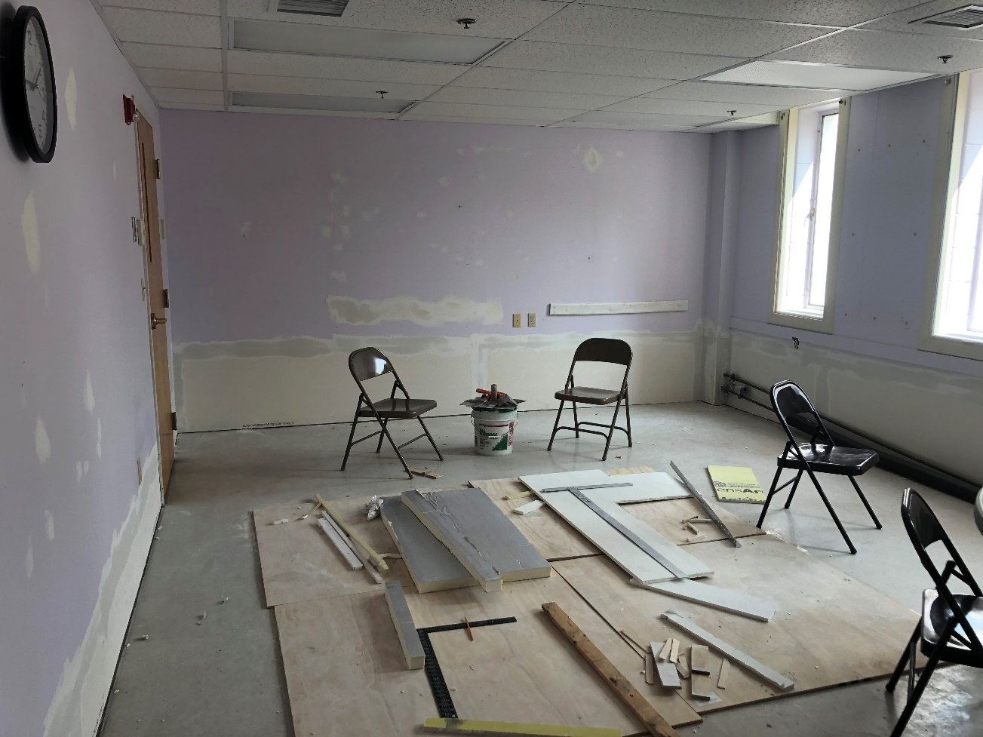
Project Nehemiah
Still going strong!

Slide 12
9/14/2020 (Summary) with update
SWOT Analysis
W: Out of sight…out of mind
O: Gospel to the parents
[Alert to where the Lord is already at work
John 4:34-35 & 5:19]
W: Member priorities
O: Spiritual growth
Frustration
Opportunities
Breakthrough
Preschool rooms
Admin Support
Website & IT
Confirmation
E-Church (beachhead)
CFM Interaction
Financial Plan
Other activities discussed:
Recruit People
Infrastructure Investment
Building Use
Building Use Committee
Repair of basement
Admin. Revamp
Preschool Interaction
Intentional mixing
Preschool Training
Small Groups
Develop/deploy group leaders
Strengths
Evangelism
Weaknesses
Lay leadership
Sunday School
E-Church (Normalized)
“Not your mother’s Sunday School”
Choir
W: Youth enthusiasm deficit
T: Cultural competition
Discipleship
Kitchen
Stewardship
Communication
(internal) 2-way
VBS
W: Time / Priority
T: Cultural competition
Failure
Threats
Battle
[Spiritual Headwinds
Psalm 22:1-18]

Slide 13
20-21 Tentative Meeting Plan
2020
January |  |  |  |  |  |  |  | February |  |  |  |  |  |  |  | March |  |  |  |  |  |  |  | April |  |  |  |  |  |  |  | May |  |  |  |  |  |  |  |  | June
Su | Mo | Tu | We | Th | Fr | Sa |  | Su | Mo | Tu | We | Th | Fr | Sa |  | Su | Mo | Tu | We | Th | Fr | Sa |  | Su | Mo | Tu | We | Th | Fr | Sa |  | Su | Mo | Tu | We | Th | Fr | Sa |  |  | Su | Mo | Tu | We | Th | Fr | Sa
 |  |  | 1 | 2 | 3 | 4 |  |  |  |  |  |  |  | 1 |  | 1 | 2 | 3 | 4 | 5 | 6 | 7 |  |  |  |  | 1 | 2 | 3 | 4 |  |  |  |  |  |  | 1 | 2 |  |  |  | 1 | 2 | 3 | 4 | 5 | 6
5 | 6 | 7 | 8 | 9 | 10 | 11 |  | 2 | 3 | 4 | 5 | 6 | 7 | 8 |  | 8 | 9 | 10 | 11 | 12 | 13 | 14 |  | 5 | 6 | 7 | 8 | 9 | 10 | 11 |  | 3 | 4 | 5 | 6 | 7 | 8 | 9 |  |  | 7 | 8 | 9 | 10 | 11 | 12 | 13
12 | 13 | 14 | 15 | 16 | 17 | 18 |  | 9 | 10 | 11 | 12 | 13 | 14 | 15 |  | 15 | 16 | 17 | 18 | 19 | 20 | 21 |  | 12 | 13 | 14 | 15 | 16 | 17 | 18 |  | 10 | 11 | 12 | 13 | 14 | 15 | 16 |  |  | 14 | 15 | 16 | 17 | 18 | 19 | 20
19 | 20 | 21 | 22 | 23 | 24 | 25 |  | 16 | 17 | 18 | 19 | 20 | 21 | 22 |  | 22 | 23 | 24 | 25 | 26 | 27 | 28 |  | 19 | 20 | 21 | 22 | 23 | 24 | 25 |  | 17 | 18 | 19 | 20 | 21 | 22 | 23 |  |  | 21 | 22 | 23 | 24 | 25 | 26 | 27
26 | 27 | 28 | 29 | 30 | 31 |  |  | 23 | 24 | 25 | 26 | 27 | 28 | 29 |  | 29 | 30 | 31 |  |  |  |  |  | 26 | 27 | 28 | 29 | 30 |  |  |  | 24 | 25 | 26 | 27 | 28 | 29 | 30 |  |  | 28 | 29 | 30
 |  |  |  |  |  |  |  |  |  |  |  |  |  |  |  |  |  |  |  |  |  |  |  |  |  |  |  |  |  |  |  | 31
July |  |  |  |  |  |  |  | August |  |  |  |  |  |  |  | September |  |  |  |  |  |  |  | October |  |  |  |  |  |  |  | November |  |  |  |  |  |  |  |  | December
Su | Mo | Tu | We | Th | Fr | Sa |  | Su | Mo | Tu | We | Th | Fr | Sa |  | Su | Mo | Tu | We | Th | Fr | Sa |  | Su | Mo | Tu | We | Th | Fr | Sa |  | Su | Mo | Tu | We | Th | Fr | Sa |  |  | Su | Mo | Tu | We | Th | Fr | Sa
 |  |  | 1 | 2 | 3 | 4 |  |  |  |  |  |  |  | 1 |  |  |  | 1 | 2 | 3 | 4 | 5 |  |  |  |  |  | 1 | 2 | 3 |  | 1 | 2 | 3 | 4 | 5 | 6 | 7 |  |  |  |  | 1 | 2 | 3 | 4 | 5
5 | 6 | 7 | 8 | 9 | 10 | 11 |  | 2 | 3 | 4 | 5 | 6 | 7 | 8 |  | 6 | 7 | 8 | 9 | 10 | 11 | 12 |  | 4 | 5 | 6 | 7 | 8 | 9 | 10 |  | 8 | 9 | 10 | 11 | 12 | 13 | 14 |  |  | 6 | 7 | 8 | 9 | 10 | 11 | 12
12 | 13 | 14 | 15 | 16 | 17 | 18 |  | 9 | 10 | 11 | 12 | 13 | 14 | 15 |  | 13 | 14 | 15 | 16 | 17 | 18 | 19 |  | 11 | 12 | 13 | 14 | 15 | 16 | 17 |  | 15 | 16 | 17 | 18 | 19 | 20 | 21 |  |  | 13 | 14 | 15 | 16 | 17 | 18 | 19
19 | 20 | 21 | 22 | 23 | 24 | 25 |  | 16 | 17 | 18 | 19 | 20 | 21 | 22 |  | 20 | 21 | 22 | 23 | 24 | 25 | 26 |  | 18 | 19 | 20 | 21 | 22 | 23 | 24 |  | 22 | 23 | 24 | 25 | 26 | 27 | 28 |  |  | 20 | 21 | 22 | 23 | 24 | 25 | 26
26 | 27 | 28 | 29 | 30 | 31 |  |  | 23 | 24 | 25 | 26 | 27 | 28 | 29 |  | 27 | 28 | 29 | 30 |  |  |  |  | 25 | 26 | 27 | 28 | 29 | 30 | 31 |  | 29 | 30 |  |  |  |  |  |  |  | 27 | 28 | 29 | 30 | 31
 |  |  |  |  |  |  |  | 30 | 31
Jan 1: New Year's Day, Jan 20: Martin Luther King Day, Feb 17: Presidents' Day, May 25: Memorial Day, Jul 3: Independence Day (obs.), Jul 4: Independence Day, |  |  |  |  |  |  |  |  |  |  |  |  |  |  |  |  |  |  |  |  |  |  |  |  |  |  |  |  |  |  |  |  |  |  |  |  |  |  | Data provided 'as is' without warranty
Sep 7: Labor Day, Oct 12: Columbus Day, Nov 11: Veterans Day, Nov 26: Thanksgiving Day, Dec 25: Christmas Day |  |  |  |  |  |  |  |  |  |  |  |  |  |  |  |  |  |  |  |  |  |  |  |  |  |  |  |  |  |  |  |  |  |  |  |  |  |  | © www.calendarpedia.com
2021
January |  |  |  |  |  |  |  | February |  |  |  |  |  |  |  | March |  |  |  |  |  |  |  | April |  |  |  |  |  |  |  | May |  |  |  |  |  |  |  |  | June
Su | Mo | Tu | We | Th | Fr | Sa |  | Su | Mo | Tu | We | Th | Fr | Sa |  | Su | Mo | Tu | We | Th | Fr | Sa |  | Su | Mo | Tu | We | Th | Fr | Sa |  | Su | Mo | Tu | We | Th | Fr | Sa |  |  | Su | Mo | Tu | We | Th | Fr | Sa
 |  |  |  |  | 1 | 2 |  |  | 1 | 2 | 3 | 4 | 5 | 6 |  |  | 1 | 2 | 3 | 4 | 5 | 6 |  |  |  |  |  | 1 | 2 | 3 |  |  |  |  |  |  |  | 1 |  |  |  |  | 1 | 2 | 3 | 4 | 5
3 | 4 | 5 | 6 | 7 | 8 | 9 |  | 7 | 8 | 9 | 10 | 11 | 12 | 13 |  | 7 | 8 | 9 | 10 | 11 | 12 | 13 |  | 4 | 5 | 6 | 7 | 8 | 9 | 10 |  | 2 | 3 | 4 | 5 | 6 | 7 | 8 |  |  | 6 | 7 | 8 | 9 | 10 | 11 | 12
10 | 11 | 12 | 13 | 14 | 15 | 16 |  | 14 | 15 | 16 | 17 | 18 | 19 | 20 |  | 14 | 15 | 16 | 17 | 18 | 19 | 20 |  | 11 | 12 | 13 | 14 | 15 | 16 | 17 |  | 9 | 10 | 11 | 12 | 13 | 14 | 15 |  |  | 13 | 14 | 15 | 16 | 17 | 18 | 19
17 | 18 | 19 | 20 | 21 | 22 | 23 |  | 21 | 22 | 23 | 24 | 25 | 26 | 27 |  | 21 | 22 | 23 | 24 | 25 | 26 | 27 |  | 18 | 19 | 20 | 21 | 22 | 23 | 24 |  | 16 | 17 | 18 | 19 | 20 | 21 | 22 |  |  | 20 | 21 | 22 | 23 | 24 | 25 | 26
24 | 25 | 26 | 27 | 28 | 29 | 30 |  | 28 |  |  |  |  |  |  |  | 28 | 29 | 30 | 31 |  |  |  |  | 25 | 26 | 27 | 28 | 29 | 30 |  |  | 23 | 24 | 25 | 26 | 27 | 28 | 29 |  |  | 27 | 28 | 29 | 30
31 |  |  |  |  |  |  |  |  |  |  |  |  |  |  |  |  |  |  |  |  |  |  |  |  |  |  |  |  |  |  |  | 30 | 31
July |  |  |  |  |  |  |  | August |  |  |  |  |  |  |  | September |  |  |  |  |  |  |  | October |  |  |  |  |  |  |  | November |  |  |  |  |  |  |  |  | December
Su | Mo | Tu | We | Th | Fr | Sa |  | Su | Mo | Tu | We | Th | Fr | Sa |  | Su | Mo | Tu | We | Th | Fr | Sa |  | Su | Mo | Tu | We | Th | Fr | Sa |  | Su | Mo | Tu | We | Th | Fr | Sa |  |  | Su | Mo | Tu | We | Th | Fr | Sa
 |  |  |  | 1 | 2 | 3 |  | 1 | 2 | 3 | 4 | 5 | 6 | 7 |  |  |  |  | 1 | 2 | 3 | 4 |  |  |  |  |  |  | 1 | 2 |  |  | 1 | 2 | 3 | 4 | 5 | 6 |  |  |  |  |  | 1 | 2 | 3 | 4
4 | 5 | 6 | 7 | 8 | 9 | 10 |  | 8 | 9 | 10 | 11 | 12 | 13 | 14 |  | 5 | 6 | 7 | 8 | 9 | 10 | 11 |  | 3 | 4 | 5 | 6 | 7 | 8 | 9 |  | 7 | 8 | 9 | 10 | 11 | 12 | 13 |  |  | 5 | 6 | 7 | 8 | 9 | 10 | 11
11 | 12 | 13 | 14 | 15 | 16 | 17 |  | 15 | 16 | 17 | 18 | 19 | 20 | 21 |  | 12 | 13 | 14 | 15 | 16 | 17 | 18 |  | 10 | 11 | 12 | 13 | 14 | 15 | 16 |  | 14 | 15 | 16 | 17 | 18 | 19 | 20 |  |  | 12 | 13 | 14 | 15 | 16 | 17 | 18
18 | 19 | 20 | 21 | 22 | 23 | 24 |  | 22 | 23 | 24 | 25 | 26 | 27 | 28 |  | 19 | 20 | 21 | 22 | 23 | 24 | 25 |  | 17 | 18 | 19 | 20 | 21 | 22 | 23 |  | 21 | 22 | 23 | 24 | 25 | 26 | 27 |  |  | 19 | 20 | 21 | 22 | 23 | 24 | 25
25 | 26 | 27 | 28 | 29 | 30 | 31 |  | 29 | 30 | 31 |  |  |  |  |  | 26 | 27 | 28 | 29 | 30 |  |  |  | 24 | 25 | 26 | 27 | 28 | 29 | 30 |  | 28 | 29 | 30 |  |  |  |  |  |  | 26 | 27 | 28 | 29 | 30 | 31
 |  |  |  |  |  |  |  |  |  |  |  |  |  |  |  |  |  |  |  |  |  |  |  | 31
Jan 1: New Year's Day, Jan 18: Martin Luther King Day, Feb 15: Presidents' Day, May 31: Memorial Day, Jul 4: Independence Day, Jul 5: Independence Day (obs.), Sep 6: Labor Day, |  |  |  |  |  |  |  |  |  |  |  |  |  |  |  |  |  |  |  |  |  |  |  |  |  |  |  |  |  |  |  |  |  |  |  |  |  |  | Data provided 'as is' without warranty
Oct 11: Columbus Day, Nov 11: Veterans Day, Nov 25: Thanksgiving Day, Dec 24: Christmas Day (obs.), Dec 25: Christmas Day, Dec 31: New Year's Day (obs.) |  |  |  |  |  |  |  |  |  |  |  |  |  |  |  |  |  |  |  |  |  |  |  |  |  |  |  |  |  |  |  |  |  |  |  |  |  |  | © www.calendarpedia.com
Council Mtgs
Strategy Mtgs
Notional Voters’ Mtgs

Slide 14
Looking Ahead
Budget approval
Emergent Requirements funding
Nominating Committee
Advent & Christmas services
LCS postured to deliver increasingly normalized ministries in COVID times

Slide 15
Old Business
None

Slide 16
New Business
Laptop and associated streaming equipment purchases

Slide 17
New Laptop to Support Streaming Services
Now: using a congregation member’s laptop to stream services
Need a laptop with enough power to do video encoding, live streaming, and light video editing
Current system is fine, but we’d like to have a dedicated system for use that can be shared and used for other things around the church too

Slide 18
Proposal
Purchase an HP Pavilion 15t Laptop – approx. $1100
Intel Core i7-1065G7 (up to 3.9 GHz, 4 cores)
16 GB RAM
512 GB M.2 SSD
Nvidia GeForce MX250 2GB graphics processor for encoding video
Lots of brands available, but we get a small discount on HP laptops through their non-profit organization program; HP is a reasonable tradeoff between performance and price
Purchase a USB microphone for Pastor’s use in video Bible studies and meetings
E.g. Blue Yeti X: https://www.bluemic.com/en-us/products/yeti-x/ - $169

Slide 19
Motion
Authorize expenditure of no more than $1500 to purchase:
Laptop to support streaming services
Microphone for Pastor’s use in Bible Studies and meetings

Slide 20
Closing Thoughts
[Jer 29:11-13 ESV] For I know the plans I have for you, declares the LORD, plans for welfare and not for evil, to give you a future and a hope. Then you will call upon me and come and pray to me, and I will hear you. You will seek me and find me, when you seek me with all your heart.
MOTION: Adjourn this Voters’ Meeting
Closing Prayer

